Slide 1
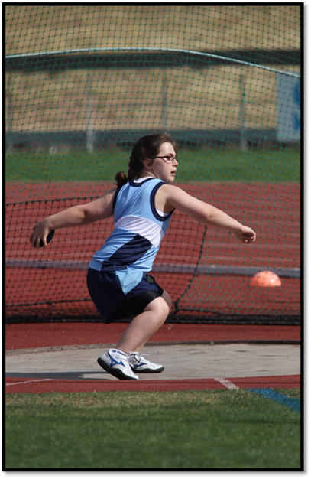
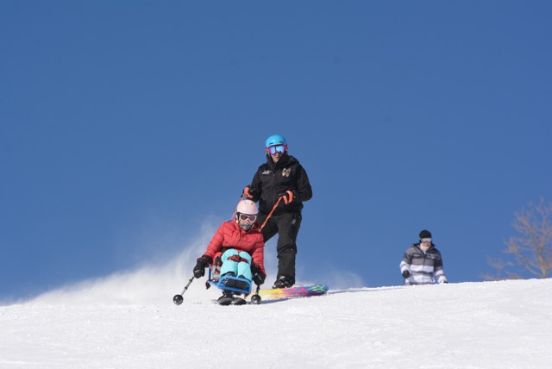
Enabling Sports Participation for Kids with Disabilities: Role of the Physio
Kerry West
Head of Physiotherapy, The Children’s Hospital at Westmead
PhD Student, Institute for Musculoskeletal Health, University of Sydney

Slide 2
Overview
Barriers to sport participation for children with additional needs eg, physical disability
Physiotherapists unique skillset
Health Professional’s role in “connecting” children to sport and physical activity opportunities
Classification for competitive sport

Slide 3
PA guidelines for children with physical disabilities
Children with disabilities
  Less active than their peers
  Should follow the same guidelines as children of the same age
    Doing some activity is better than doing none
    Start with small amount and build up
    Consult a health professional for guidance

Slide 4
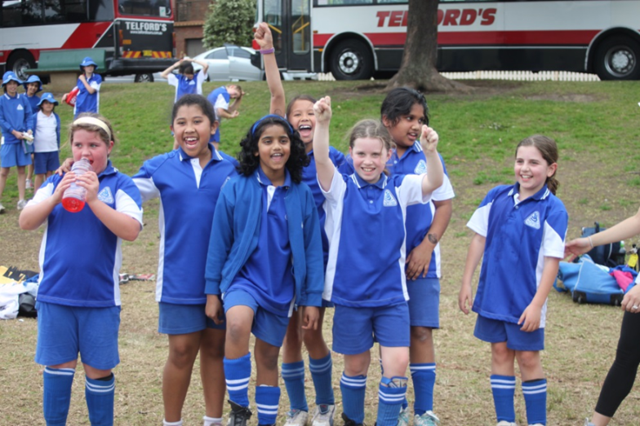
Barriers to Sport Participation
Physical abilities and limitations
Cognitive skills
Social skills and behaviour
Parental support
Accessibility and equipment
Program availability
Costs
Attitudes and knowledge
Motivation

Slide 5
Physiotherapy Specific Skills
Profession-specific knowledge
  Human motor performance
  Biomechanics
  Motor development
Disability specific knowledge
Analysis of impairment and problem solving
Working with individuals and families
Working in a team
Working across a range of settings

Slide 6
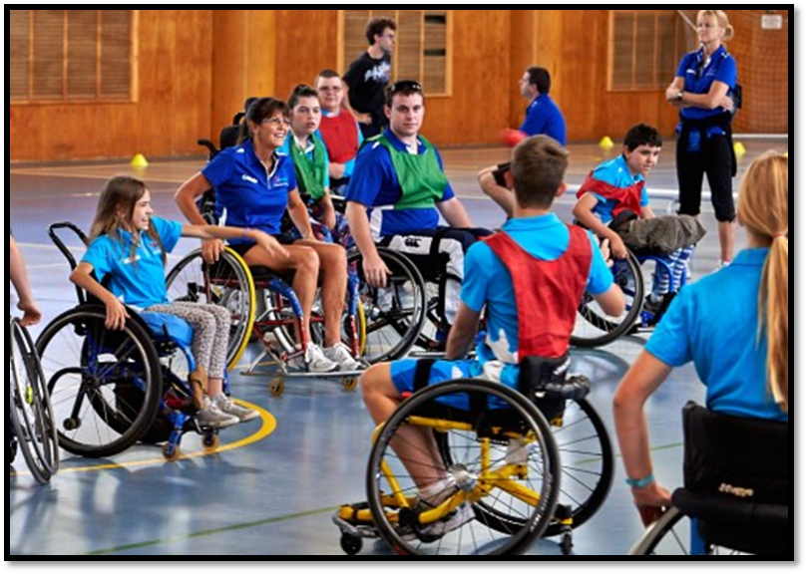
How can physios help to break down some of the barriers that exist?

Slide 7
Physio Interventions
Early intervention and motor skill development
Target therapy towards sport specific goals
Assist coaches to effectively target strengthening and training programs
Help to advise re modifications to activity to accommodate physical limitations

Slide 8
Guidance to Families
Advice about suitable sports and physical activities
Build an awareness of sporting clubs and organisations in local area
Support and empower individual choices
Promote benefits of sport and encourage participation

Slide 9
Capacity Building
Take an active role to support community organisations
  Schools
  Sports clubs
  Coaches
  Community groups
Develop sport-specific knowledge
Promote use of resources, equipment
Utilise problem-solving skills to adapt activities if necessary

Slide 10
How can kids get involved in sport?
Depends on level and type of disability
If possible join local able-bodied club, organisation
Find coaches and clubs that support disability inclusion
Join a disability sport organisation eg, Special Olympics, CPSARA
Attend a “Come and Try” day

Slide 11
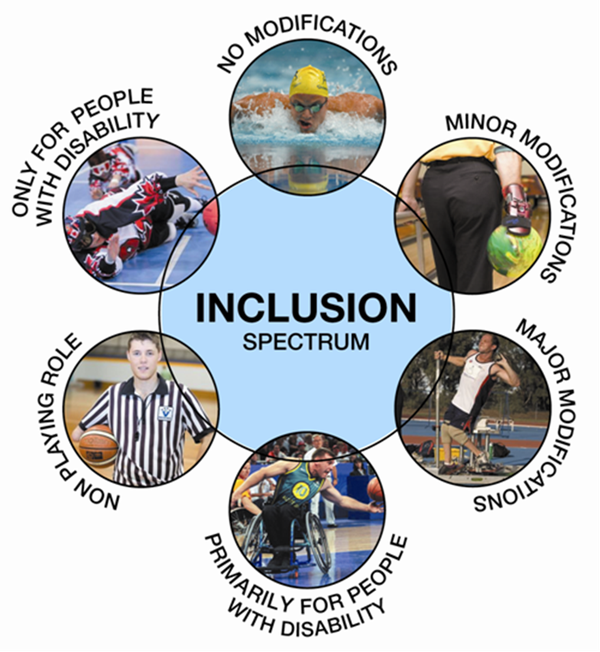
The Inclusion Spectrum

Slide 12
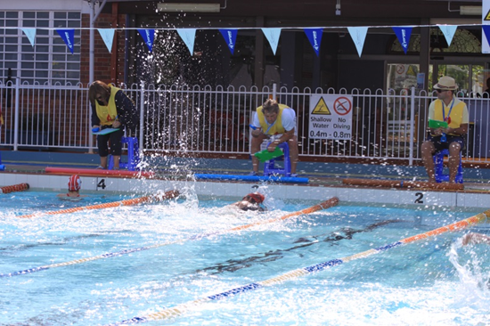
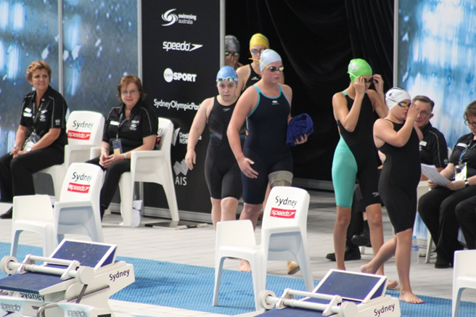
Swimming
Learn to Swim
Join a local swimming club
Get classified
Start competing
  School pathways
  Club competitions
  Swimming NSW Multi-class

Slide 13
What are we learning along the way?
Pathways are very sport specific
Wide variety of abilities and interests
Individual and varied barriers to participation
Really important to try to find the right level of sport or activity
Not everyone will become a Paralympian and not everyone wants to
Identifying both elite pathways via classification and also opportunities to just have fun and keep active

Slide 14
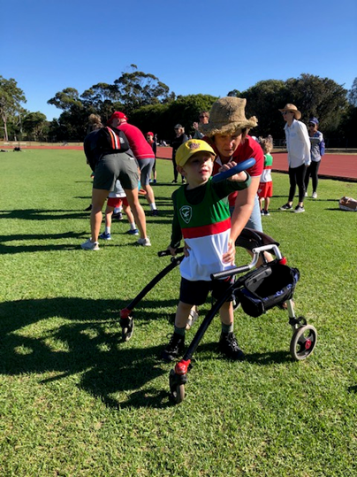
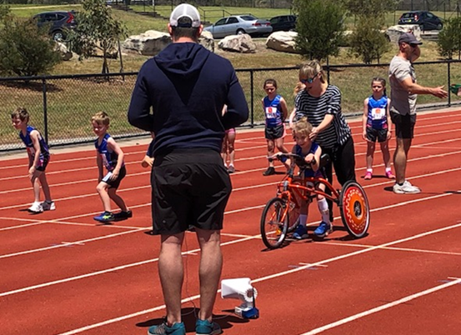
Increasing Physical Activity in Children With Disabilities Through Little Athletics Participation

Slide 15


Slide 16
Disability sport - Getting classified
Paralympic sports
Competition ready
Availability of classification
Level of classification required

Slide 17
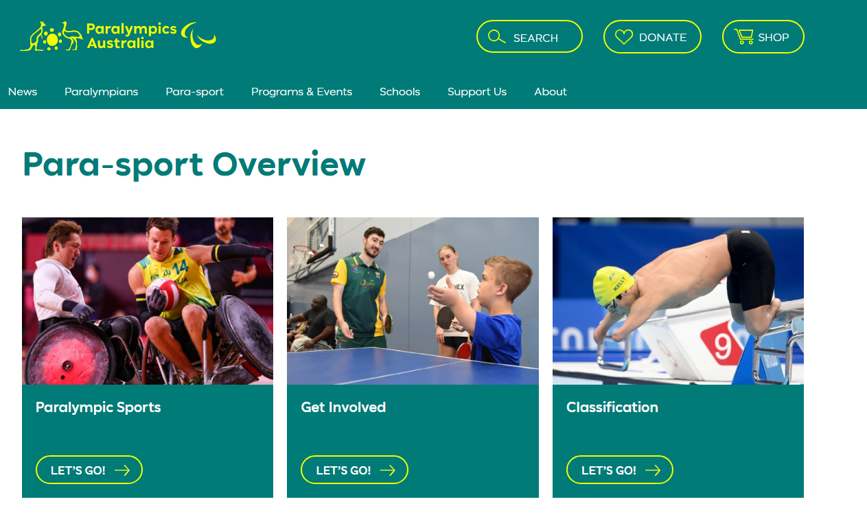
Paralympics Australia www.paralympics.org.au

Slide 18
Summer Paralympic Sports
Athletics | Swimming
Boccia Badminton | Goalball Taekwondo
Football | Equestrian
Rowing | Sailing
Shooting | Wheelchair Basketball
Wheelchair Tennis | Wheelchair Rugby
Table Tennis | Wheelchair fencing
Para-canoe | Para-triathlon
Archery Powerlifting Climbing | Volleyball (sitting) Judo

Slide 19
Classification
Classification groups athletes who have similar impairments together into classes for competition in their particular sport
Aims to remove the level of impairment as a factor that determines outcome of competition
Sport Specific
Can determine eligibility
Allow for Multi-class competition
(eg, school sport)

Slide 21
Who can classify
How are classifiers trained?
Sport federation determines rules on classifier panel
Medical classifiers: Dr., Physio or equivalent
Technical Classifier: sport science, coach
Background in sport and/or rehabilitation
Sporting organisations
Classifier Pathway as per IPC classification Code
Theory, Observation, Practical, Under supervision, exam
Regular re-accreditation
National and International pathways

Slide 22
Determining Impairment
Eligible impairment types
An Impairment must be:
  Arising from an underlying health condition that can be verified
  Permanent
  Measurable
  Training cannot improve the impairment
Vision Impairment
Intellectual impairment
Hypertonia
Ataxia
Athetosis
Limb Deficiency
Leg Length difference
Short stature
Impaired Passive Range of Movement
Impaired Muscle Power

Slide 23
Overview of Process
Determine main physical impairment
Decide what testing is required for "Bench” Test
Series of medical / physical assessments
Measurement of impairment
Assessment of sport specific function and general skills
Compare results against classification rules – is eligible then determine class
Observation during competition to confirm class
Status of review or confirmed

Slide 24
Provisional Classification
Check availability of National classification opportunity first
Only need to fill out form for the main impairment type
Can fill out multiple sections if significant other impairment impacting function
eg, amputee with multiple contractures

Slide 25
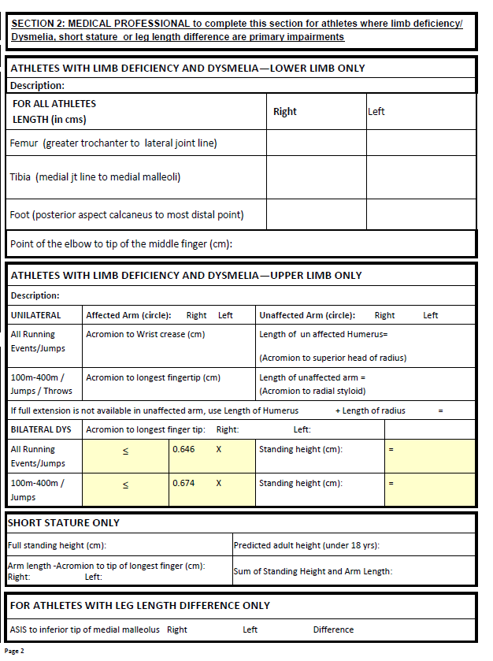
Athletics Australia: provisional classification: https://www.athletics.com.au/multi-class-athletics/physical-impairment/

Slide 26
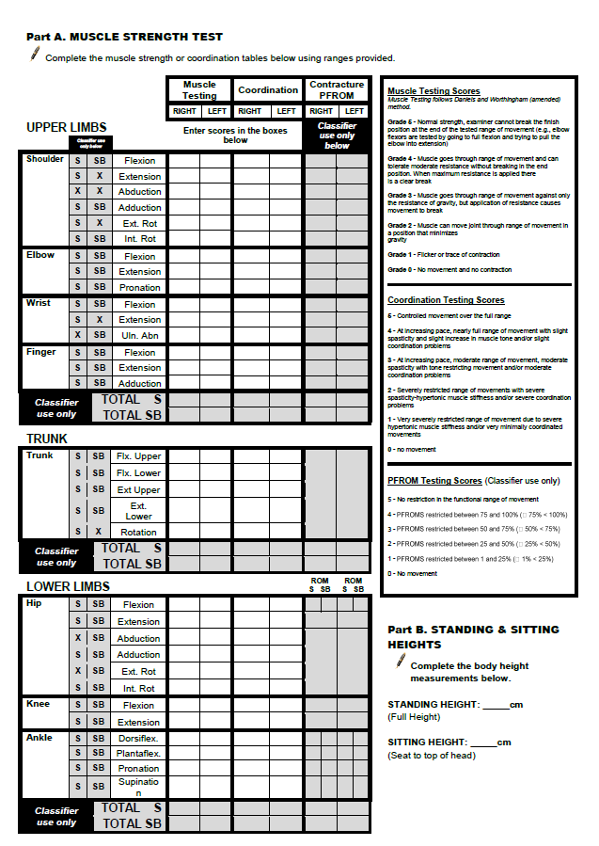
Swimming Australia Classification information:
https://www.swimming.org.au/performance/elite/classification

Slide 27
